Slide 1

By: Jessica Edouard, Emmanuel Teferi, Justin Tran, and Henry Wang

Slide 2
Introduction
There is a long running history of amazing arcade style space themed games:
Space Invaders (1978)
Galaga (1981)
Star Wars video games (1983-2019)
Star Fox (several made from 1993-2017)
“Princeton 2020: A Space Odyssey” is an immersive space flight game where the player must navigate an ongoing asteroid field while also collecting enough fuel to survive. The player must:
Pilot a spaceship in first person perspective
Collect fuel charges to stay alive
Collect powerups that provide temporary protection
Avoid asteroids

Slide 3
Goals
Create a highly stylized immersive gaming experience
Centered around an outer space theme
An emphasis on smooth flight movement and high stylization
High performance in a 3D space using three.js
Apply the skills acquired in the former half of COS 426
Create a short yet enjoyable gaming experience

Slide 4
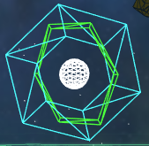
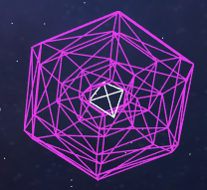
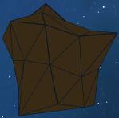
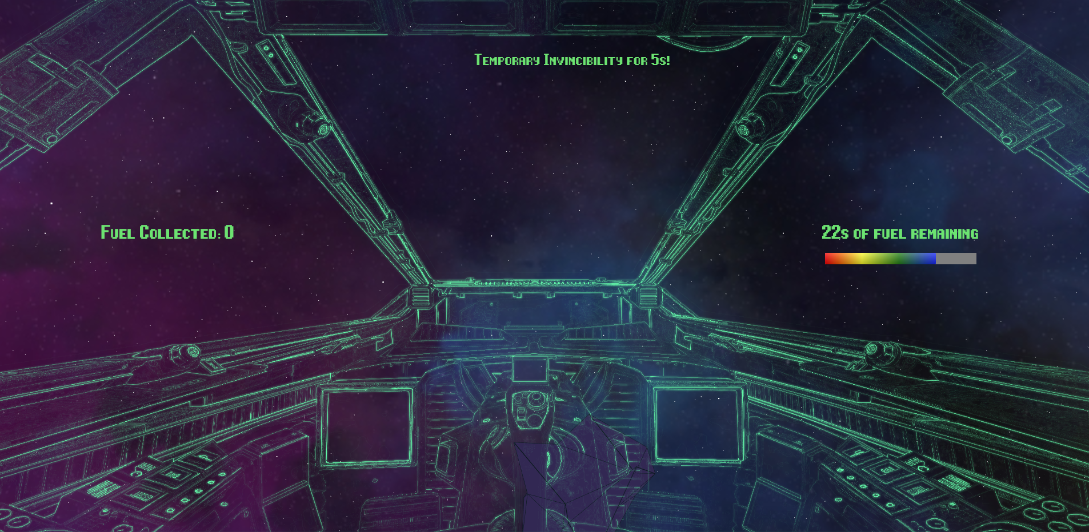
Design
Fuel charges, invincibility power-ups, and asteroids
A minimal but immersive HUD
A sense of “space” in outer space
Skybox, skybox features
Particles
Cockpit image
Notes:
Building off of our goal, we kept the rules of our game simple which was basic objection avoidance and object collection. Seeing that we are a space adventure themed game, here we have three models for those concepts in the game: fuel charges, invincibility power-up, and a basic asteroid model.
So in order to win the game, the player needs to collect fuel charges while avoiding asteroids that are coming their way.
We decided to do whit with three.js and tween for animation and cannon.js for physics.
The fuel charges and invincibility power were both unique meshes made by our team, and the inspiration for this was going off of sci-fi inspired but arcade stylization. Hence we had the idea of using wireframes animating different rotations to provide this effect. The asteroid was a model used from Google Poly and we simply changed the texture of the model and added a wireframe outline to give it a more game-y type feel. In the game youre in a cockpit, and that was taken from a resource archive cockpit which we edited to be transparent so the user could see more of their screen. The heads up display also has text on the left telling the user what their score is essentially and on the right their fuel levels—which is what they’re trying to maintain for as long as possible. We have some stylizations here which includes a space themed skybox and a particle system that speckles the background with white dots to give a more dynamic space type of feel.

Slide 5
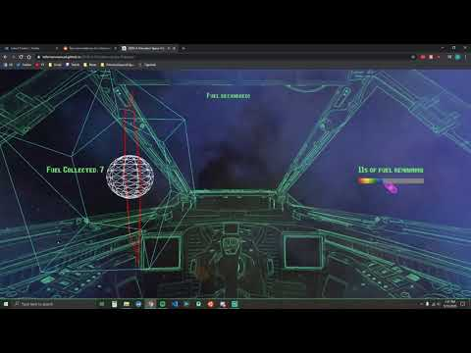
Demo
Notes:
Justin will narrate this and speak about the menu, menu options, controls + instructions, cockpit and HUD choices, sound effects, general course of gameplay, etc.

Slide 6
Implementation Challenges and Difficulties
Changing the style of our project from level-based to survival-based
Defining a simple yet effective control scheme
Analog control via mouse vs. directional control via arrow keys
Defining the exactly the dimensions of the game bounds
Exactly what should the behavior be when player approaches bounds?
Implementing physics and collision detection with Cannon.js
Finding a difficulty that would fit all players
Some said it was extremely hard while some said it was way too easy
Notes:
We encountered many challenges with creating our game.
In the beginning, we planned on making a level-based game where the main objective was to collect enough fuel within a given time limit. However, we realized that having the main objective be surviving as long as possible would be more interesting and compelling.
Another major challenge was finding a set of controls that was simple, intuitive, and effective. After much deliberation, we realized that having the mouse move the camera was much more intuitive and offered greater freedom of movement than arrow keys did.
Another challenge was figuring out the exact behavior when the player reaches the bounds of the skybox.
When implementing collisions, for a very brief moment, we actually discussed using arbitrary triangular mesh collision but realized this was too complex and unoptimized. Hence, we instead used the existing Cannon.js library for physics and collision simulations.
Finally, finding a difficulty that would suit all players was tough because our survey for our MVP (minimum viable product) had opinions all over the place. Some thought it was too easy while some thought it way too hard. Eventually, we settled on making the fuel last longer at the cost of more obstacles in the scene.

Slide 7
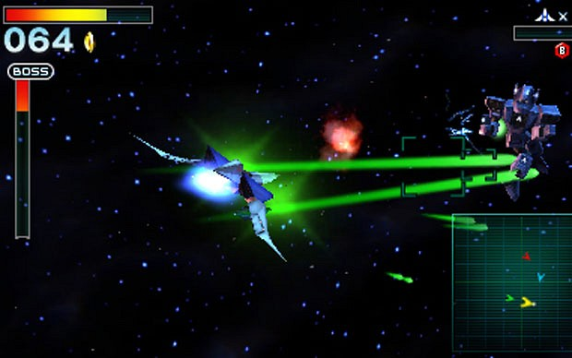
Future Work
Difficulty Levels - Easy, Medium, Hard
Enemy ships with varying AI
Fuel depletion rate, ship speed, number of obstacles, etc.
Aiming reticle with lasers, heat-seeking missiles, shields
Powerup could either give weapons or improve on base set
Improving average performance across machines
Animated cutscenes and voice acting for visual storytelling experience
Toggle between third person view and first person view
Notes:
While we accomplished every single goal we set out to do and then some more, like the barrel roll stretch goal, there are still so many more directions to take this project in the future.
First off, given the class feedback on our project, having difficulty levels would be a nice addition. Having enemy ship AI, fuel depletion rate, ship speed, and number of obstacles tied to the difficulty setting would allow for a more inclusive gaming experience.
Second, weapons for the player to fight off enemy ships and destroy obstacles would be a nice touch. An aiming reticle along with powerups like bombs or shields would contribute to the atmosphere of the game.
Third, there's always room for optimization and improving the frame rate across all machines would allow for a smoother performance.
Next, animated cutscenes with in-house voice acting is admittedly ambitious but would contribute to the overall narrative and storyline behind our game.
Finally, offering a toggle between first person view and third person view would offer greater freedom of control to the player.

Slide 8
Acknowledgements
All of the TAs for their wonderful instruction (especially Reilly Bova and William Sweeny <3)
Professor Heide for his instruction this semester
Everybody that played our MVP and gave feedback

